Slide 1


NAUTICAL EYE SYSTEM
A DIGITAL SUITE FOR SHIP DETECTION
Debisha Ghosh & Sampurna Saha

Slide 2
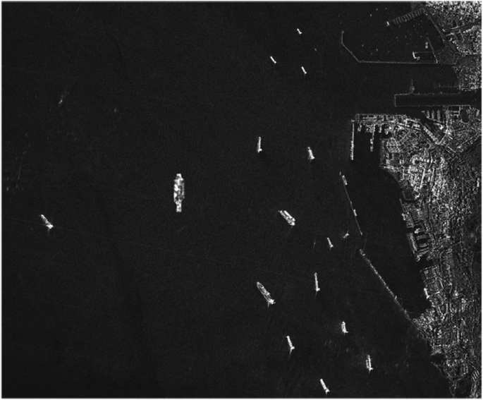
INTRODUCTION
Maritime surveillance is critical in national security, environmental monitoring, and managing marine traffic.
Traditional methods often face challenges due to cloud cover, night-time limitations, and limited processing capabilities.
Synthetic Aperture Radar (SAR) overcomes these obstacles by providing all-weather, day-and-night imaging capabilities.
Leveraging the Google Earth Engine (GEE) cloud platform enables efficient processing of large-scale SAR datasets, facilitating near real-time analysis and detection.

Slide 3
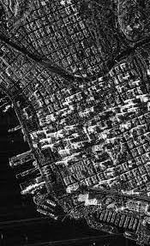
OBJECTIVES
Harnessing Sentinel-1 SAR imagery and using GEE to develop a workflow for automated ship detection.
Creating a web application for visualizing ship movement tracks.

Slide 4
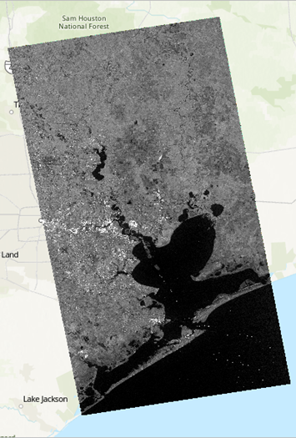
Understanding Synthetic Aperture Radar (SAR)
Active remote sensing system that transmits microwave signals and records their backscatter.
Operates independently of sunlight—ideal for nighttime imaging.
Penetrates clouds, rain, and haze, making it reliable for all-weather monitoring.
Measures surface roughness, structure, and moisture, useful for maritime object detection.
Generates high-resolution images using Doppler shift and platform motion.

Slide 5
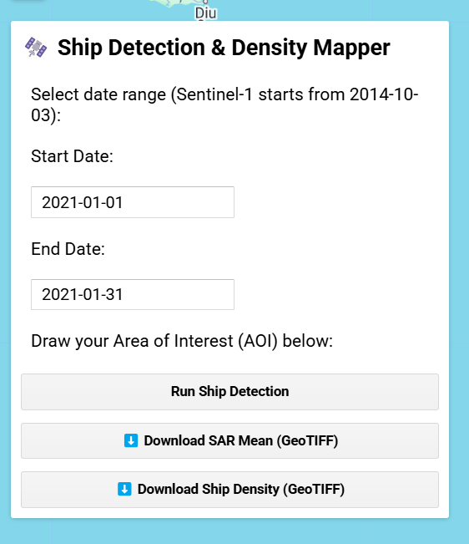
Development of the Model
#UI Panel: The Control Sidebar
var panel = ui.Panel({
style: {width: '350px', position: 'top-left', padding: '8px'}
});
creates a sidebar panel on the top left of the map for all the controls
panel.add(ui.Label('Ship Detection & Density Mapper', {
fontWeight: 'bold',
fontSize: '18px',
margin: '0 0 10px 0'
}));
adds title to the panel
panel.add(ui.Label('Select date range (Sentinel-1 starts from 2014-10-03):'));
var startDate = ui.Textbox({placeholder: 'YYYY-MM-DD', value: '2021-01-01'});
var endDate = ui.Textbox({placeholder: 'YYYY-MM-DD', value: '2021-01-31'});
adds text boxes where users can enter the start and end dates for ship detection

Slide 6
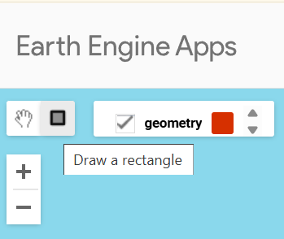
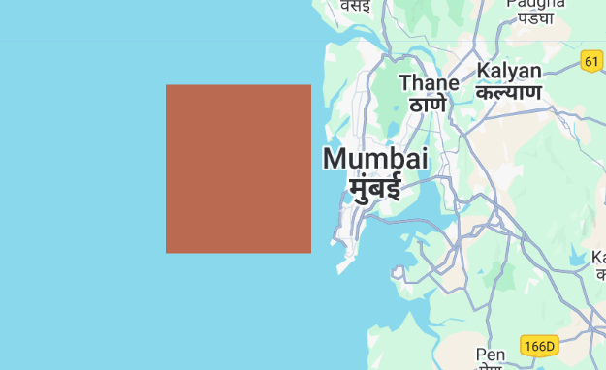
Development of the Model
#Drawing AOI (Area of Interest)
panel.add(ui.Label('Draw your Area of Interest (AOI) below:'));
Map.setCenter(72.85, 19.1, 9);
Allows the user to draw a rectangle around their AOI.
var drawingTools = Map.drawingTools();
drawingTools.setShown(true);
drawingTools.setDrawModes(['rectangle']);
drawingTools.layers().reset();
drawingTools.draw();
enables a rectangle drawing tool on the map for AOI.

Slide 7
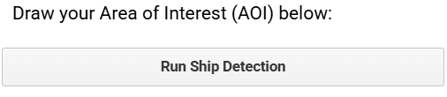
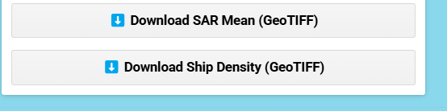
Development of the Model
#Buttons
var detectButton = ui.Button({ label: 'Run Ship Detection', onClick: detectShips });
panel.add(detectButton);
adds a button labeled “Run Ship Detection”
var downloadSARButton = ui.Button({ label: 'Download SAR Mean (GeoTIFF)', onClick: exportSAR });
var downloadDensityButton = ui.Button({ label: 'Download Ship Density (GeoTIFF)', onClick: exportDensity });
Two more buttons let you download results:
The mean radar image (SAR)
The ship density heatmap

Slide 8
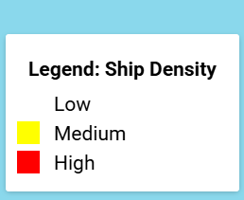
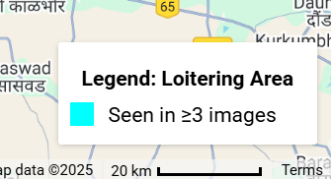
Development of the Model
#Legends
var densityLegend = ui.Panel({ position: 'bottom-left', backgroundColor: 'white' });
var loiterLegend = ui.Panel({ position: 'bottom-right', backgroundColor: 'white' });
panels are added in corners to show map legends:
Left: Ship density color legend
Right: Loitering ships
function detectShips() {
...
}
var s1 = ee.ImageCollection('COPERNICUS/S1_GRD')...
var shipMask = function(img) {
var ships = img.gt(-15).selfMask();
...
};
var detected = s1.map(shipMask);
This defines how to find ships in radar images
Any radar value above -15 dB is likely a ship.
The Actual Ship Detection Logic
Applies that function to each satellite image to find ships in all of them.

Slide 9
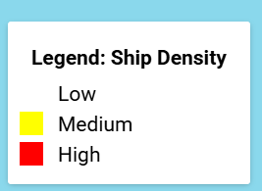
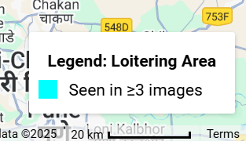
Development of the Model
#Creating Layers
shipDensity = detected.sum().clip(aoi);
sarMean = s1.mean().clip(aoi);
var loiterAreas = shipDensity.gte(3);
Map.addLayer(...);
Ship density
Mean radar image
Loitering ship locations (cyan)
Places where ships appeared in 3 or more images
#Legend Definitions
function showLegends() {
...
}
function exportSAR() { ... }
function exportDensity() { ... }
Ship density:
White = Low
Yellow = Medium
Red = High
Cyan = Ship seen ≥ 3 times → possibly loitering

Slide 10
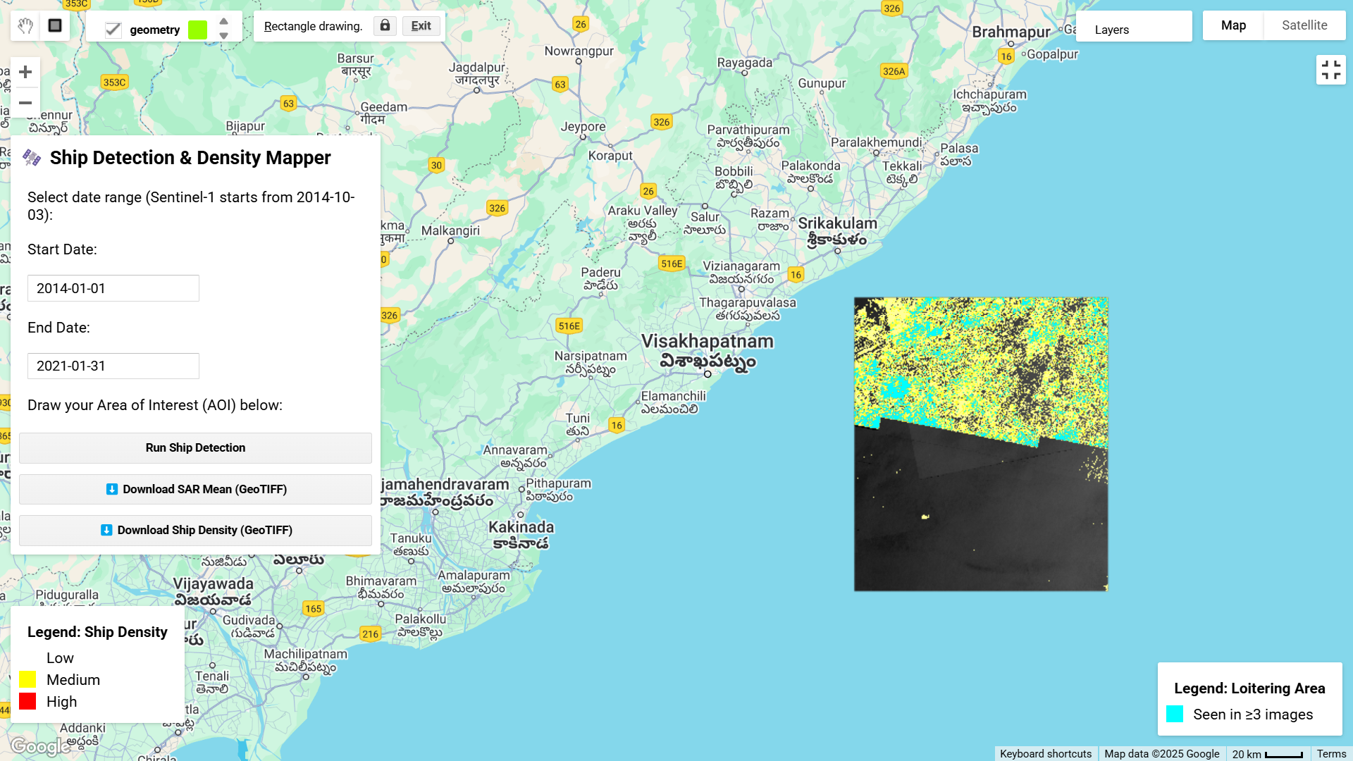
Web Page
EAST COAST OF INDIA

Slide 11
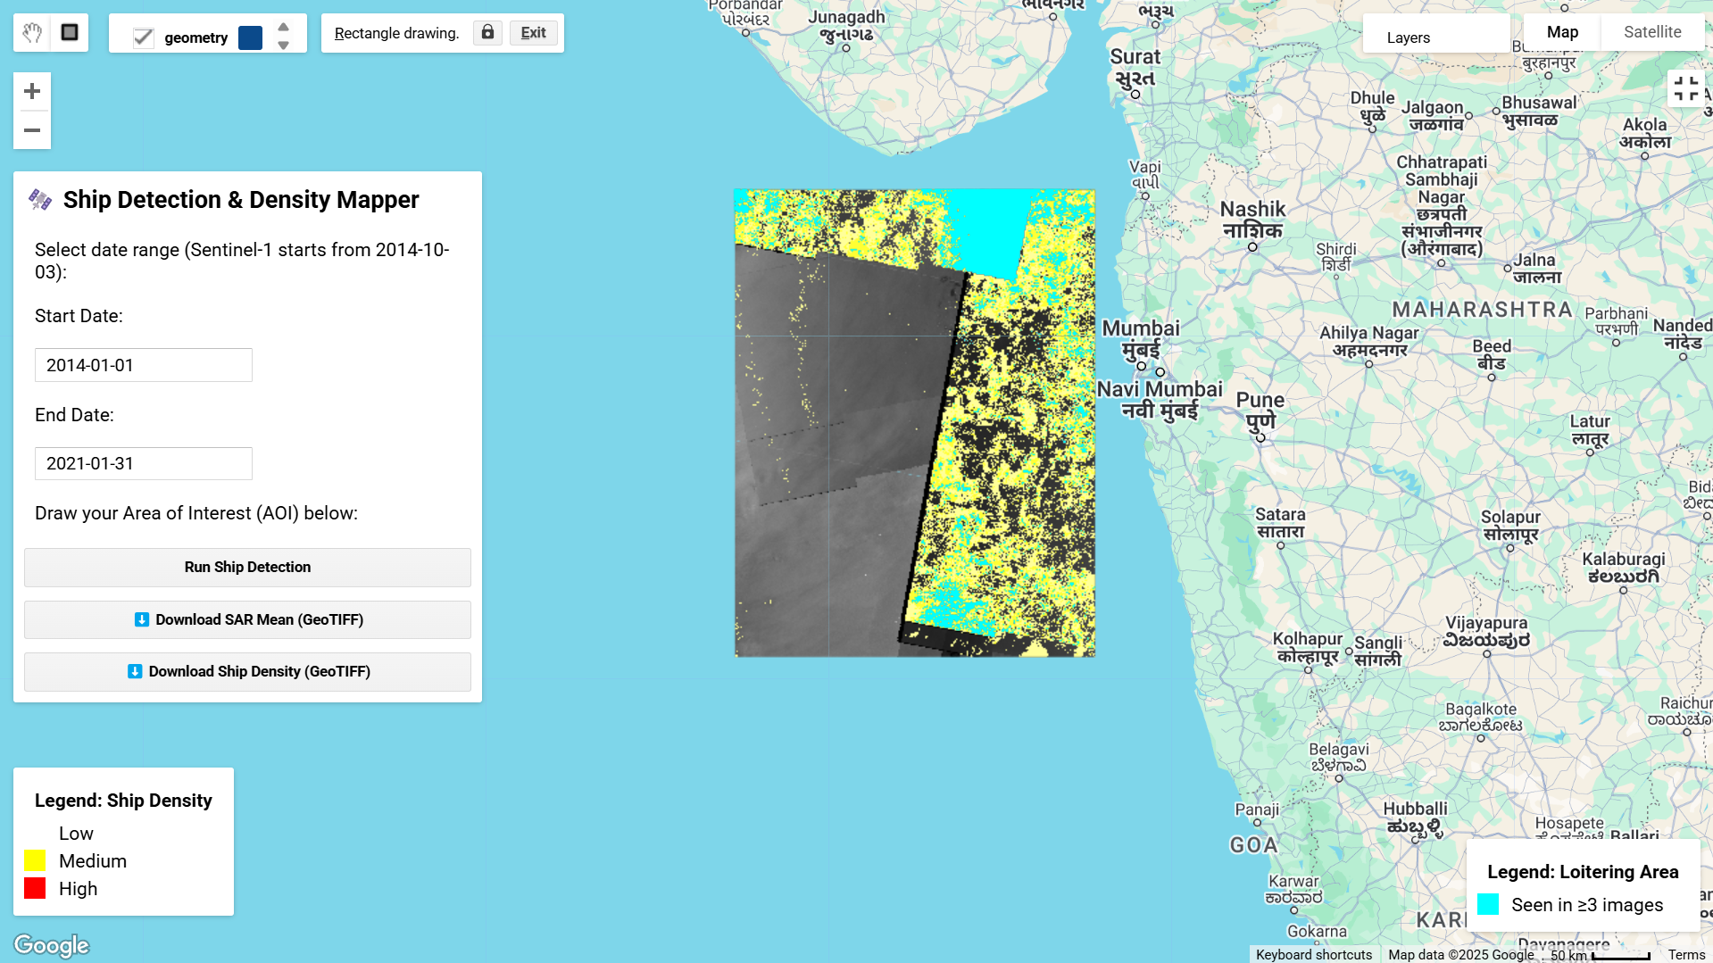
Web Page
WEST COAST OF INDIA

Slide 12
CONCLUSION
Automated Ship Detection: Utilizes Sentinel-1 SAR imagery to detect ships based on radar backscatter thresholds, enabling reliable identification regardless of cloud cover or daylight.
Temporal Analysis of Movement: Maps ship density over a user-defined date range, helping assess traffic intensity and frequently visited regions.
Loitering Detection: Identifies potential loitering zones by highlighting areas with ≥3 detections, aiding in anomaly detection and maritime security.
User-Friendly Interface: Built with GEE’s UI tools, allowing interactive AOI selection, parameter input, visualization, and direct download of analysis outputs.
Scalable and Reproducible: Adaptable to any coastal region globally with minimal modification, making it a robust tool for large-scale monitoring and research.

Slide 13
THANK YOU!

